Slide 1
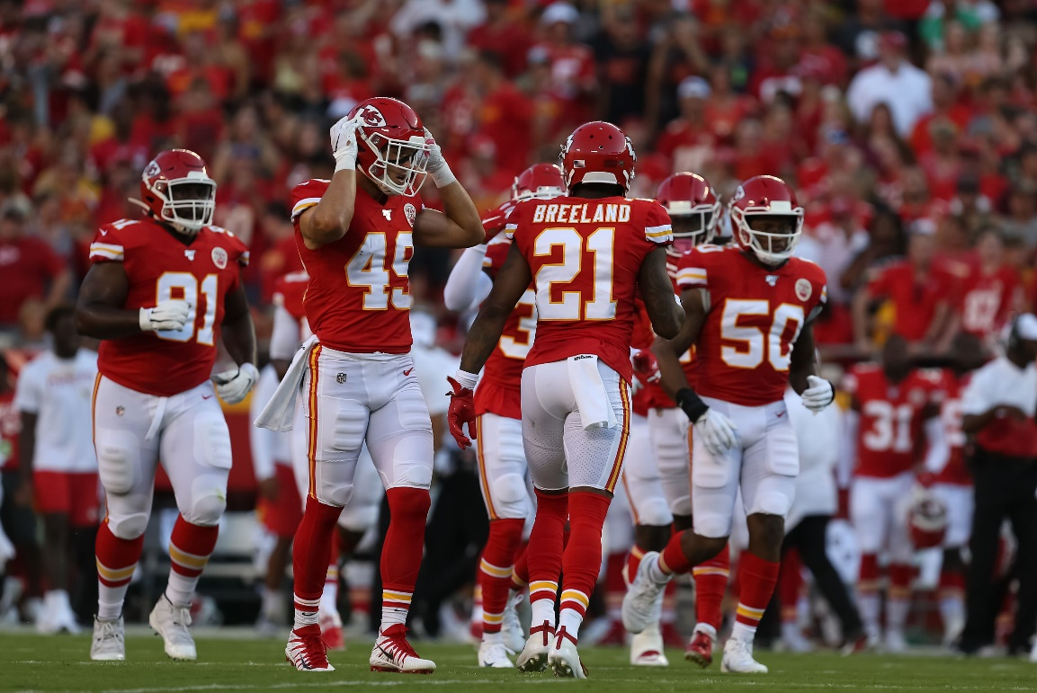
2019 NFL Stats
This Photo by Unknown Author is licensed under CC BY
Emmanuel Ayoo, Katie Buckner, Michelle Goodman, Polina Holland

Slide 2

Are You Ready for Some Football?!?
Why in the world would be choose to do football stats?
We all enjoy the football season and are looking forward to it starting!
We wanted to share the football love and introduce others to the joys of the NFL.
So we all learned a little (Or a lot) more about it!
This Photo by Unknown Author is licensed under CC BY-SA

Slide 3
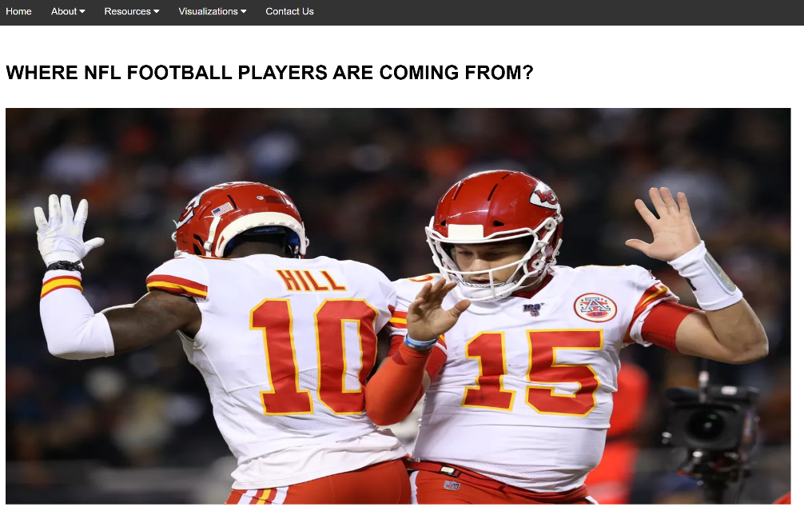
So What Are We Hoping to Share?
By using charts and graphs we want people to be able to see if there are correlations between college, height, weight, and hometown, etc. Like…do quarterbacks really make the most money?
We wanted it to be simple so someone not familiar with football would still be able to see connections and understand them.

Slide 4
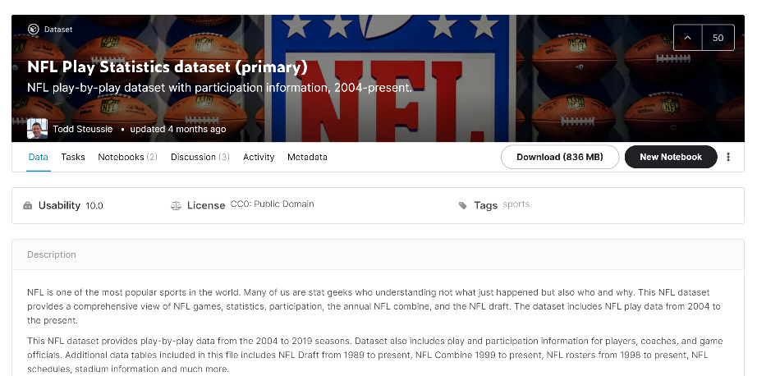
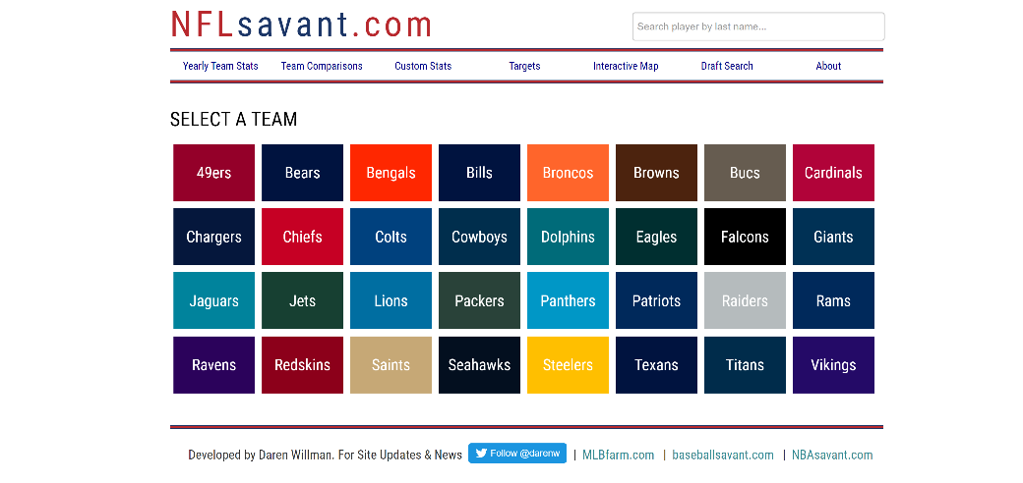
The Data
NFL Savant
NFL Savant in particular had the salary data we were looking for.
http://www.nflsavant.com/
Kaggle
We found a HUGE dataset in two parts on Kaggle detailing information about individual players.
https://www.kaggle.com/toddsteussie/nfl-play-statistics-dataset-2004-to-present
https://www.kaggle.com/toddsteussie/nfl-play-statistics-secondary-datasets

Slide 5
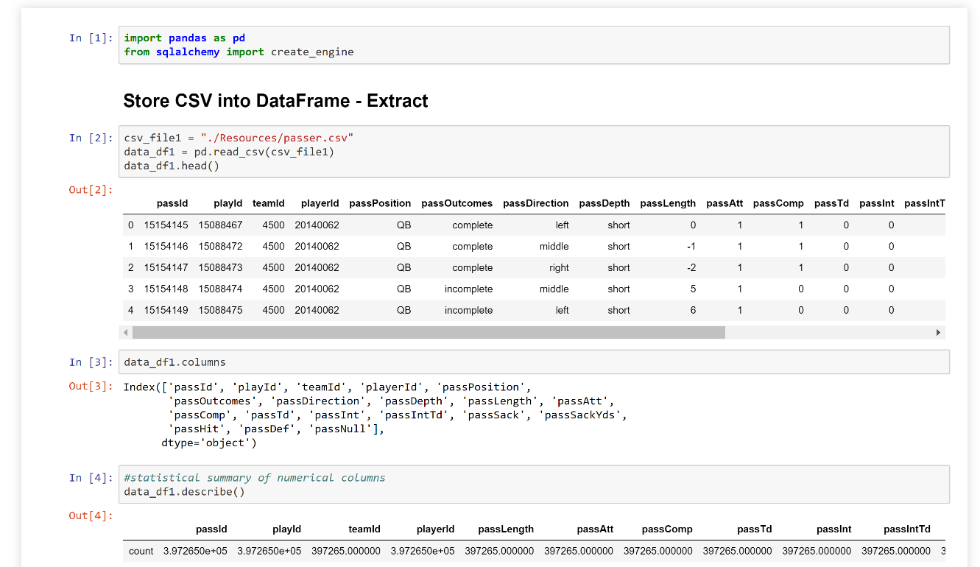
Data Wrangling
We decided to use the data we cleaned for our ETL project. As part of the process we imported the data, extracted the info we needed, cleaned and transformed it, and then loaded it to a Sqlite database to use in our project.

Slide 6

What Programming Tools Did We Use?
Python Flask Server
SQLite
Javascript
JSON
HTML
CSS
Highcharts
Frappe
D3.js
API Call

Slide 7

The Good Stuff: The visualizations and dashboard
We designed our initial dashboard with a navigation bar that leads to our data sources, and our visualizations.

Slide 8
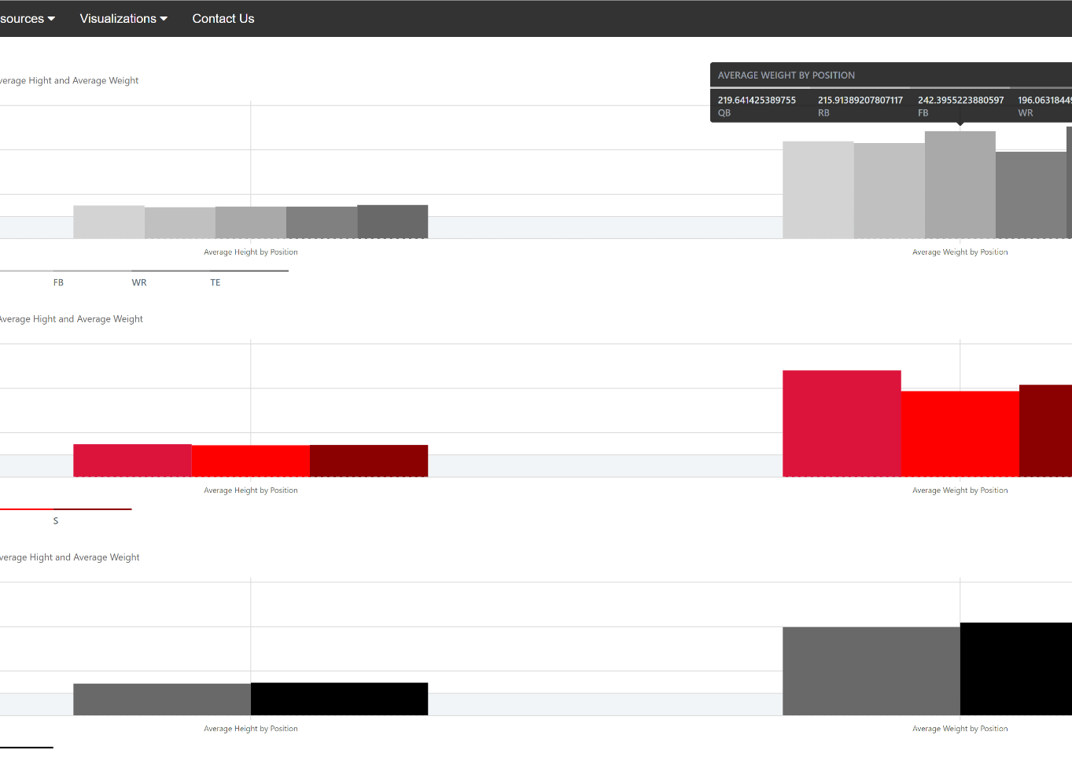
Bar Charts
Frappe framework!

Slide 9
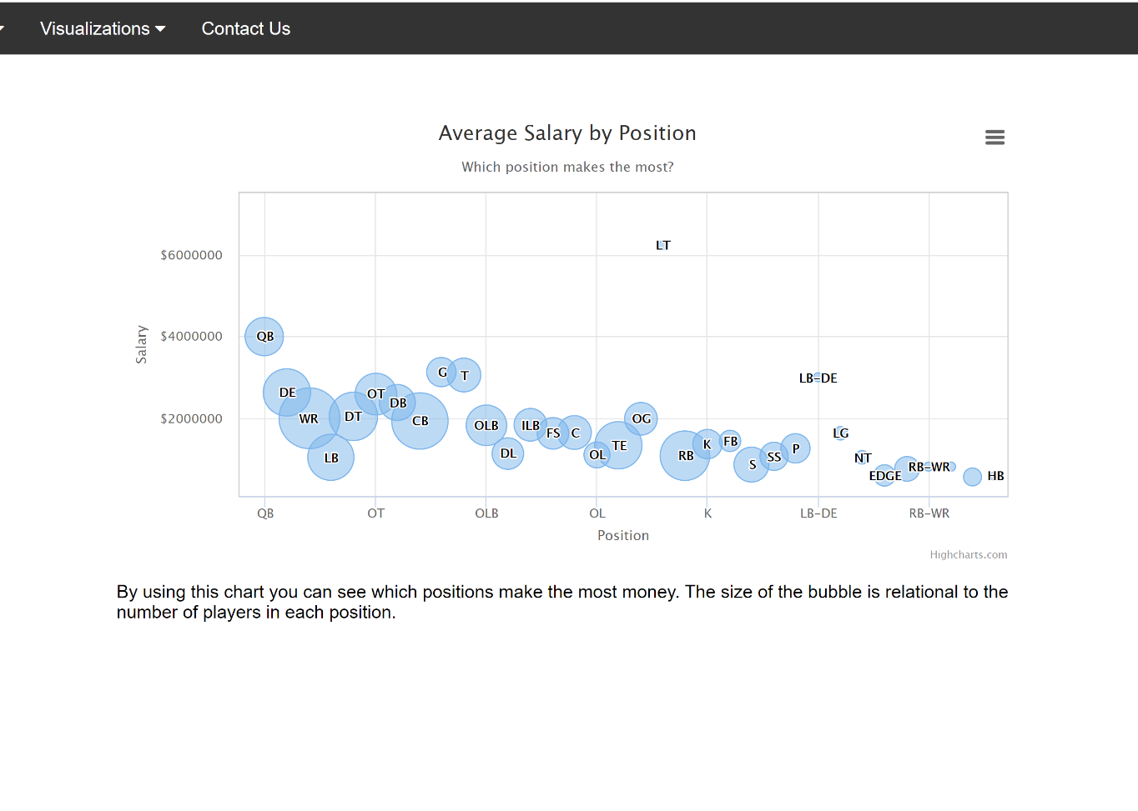
Bubble Chart!
Using the Highchart library allowed to chart the salary data as a bubble chart.

Slide 10
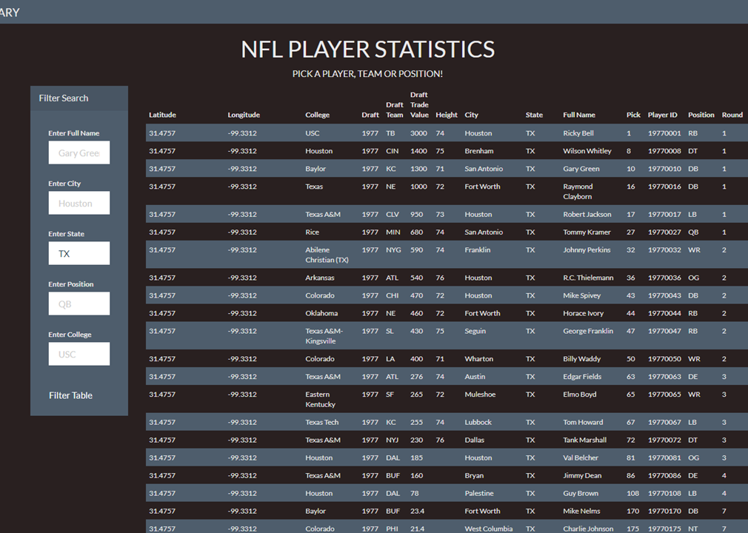
Searchable Data
This dynamic table allows users to filter through the NFL data for specific values of interest.
The filter function makes the table concise, robust, and user friendly.

Slide 11

Problems, Problems, Problems!
We ran into several problems while completing our project
Our biggest issue was figuring out how to read the information from our app.py into our javascript files correctly.
There was a lot munging that had to be done within some of the HTML files to get the data in the format needed for the visualizations.
Getting files working nicely together that came from four different machines was a CHALLENGE.
This Photo by Unknown Author is licensed under CC BY-SA

Slide 12

Any Questions or Comments?
This Photo by Unknown Author is licensed under CC BY-NC-ND

